Slide 1
Representations
Mobile Robotics 2023

Slide 2
Brief Review
Space-fixed (Extrinsic Rotation) vs body-fixed frame (Intrinsic Rotation)
Euler angles in space-fixed frame vs body-fixed frame

Slide 3
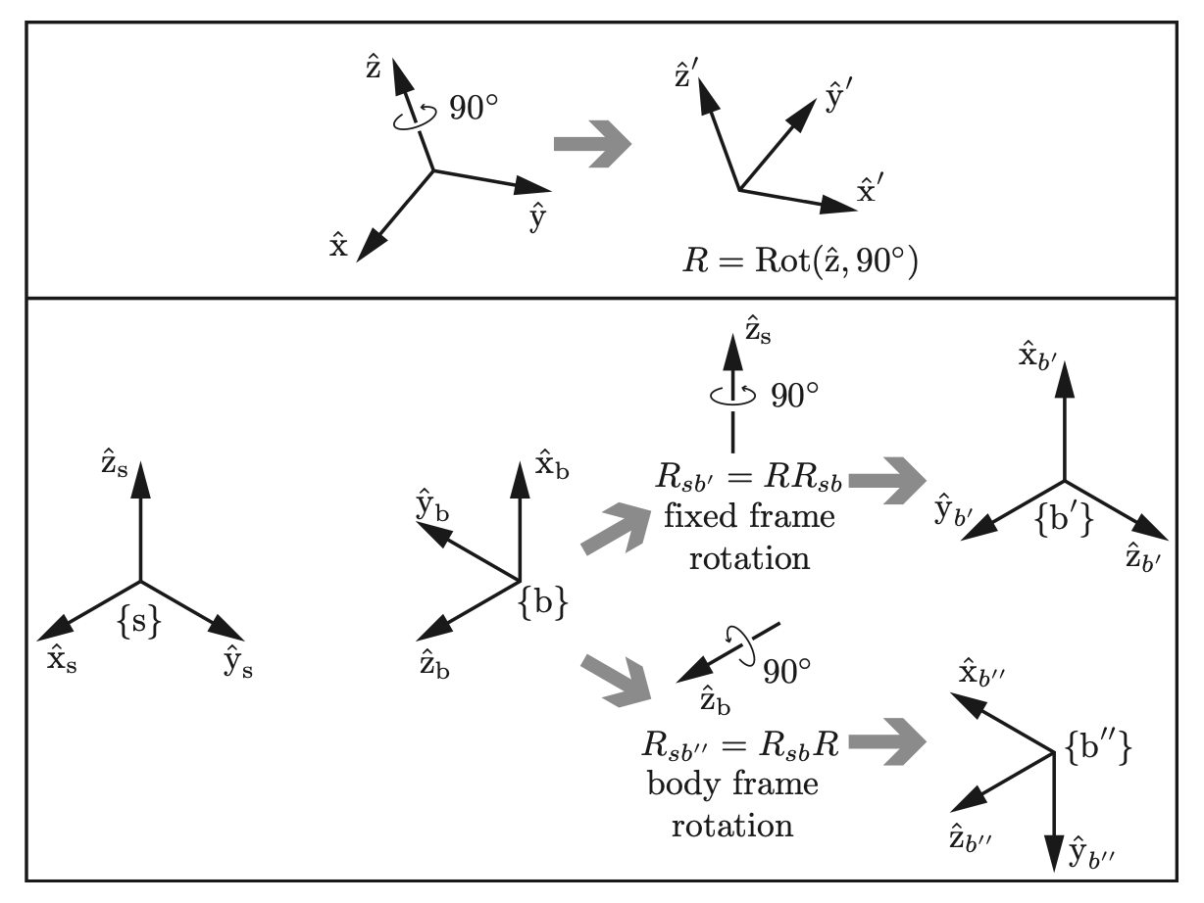
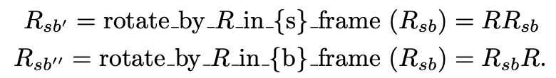

Slide 4
Today
Additional disadvantages with Euler Angles
Gimbal Lock
Quaternions
Introduction
Quaternion Algebra
Rotation in Quaternions
Rotation Matrix ⇔ Quaternions
Axis Angles ⇔ Quaternions
Interpolation

Slide 5
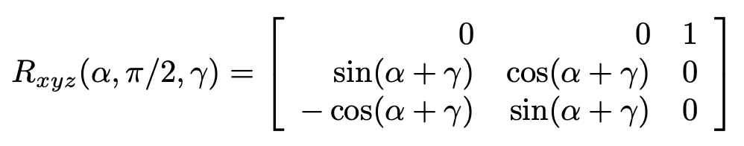
Gimbal Lock - Computational Perspective

Slide 6
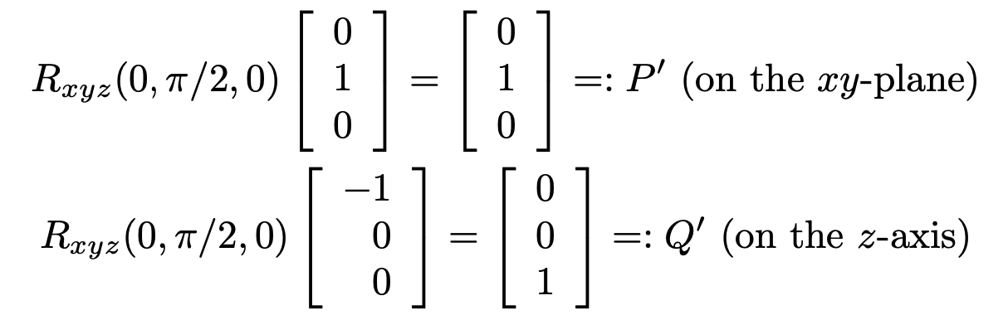
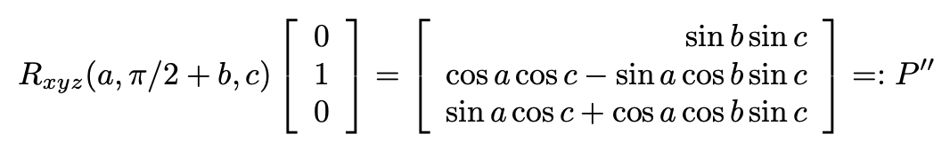
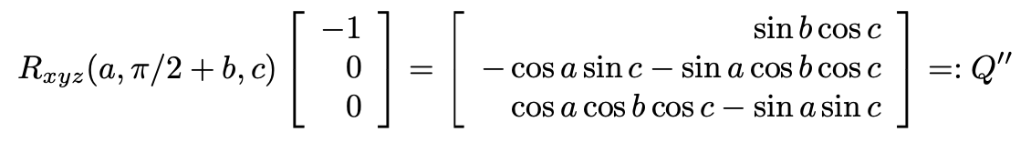
Gimbal Lock
Now, rotate the rigid body about the z-axis of space-fixed frame

Slide 7
Gimbal Lock - Computation Perspective
Cannot reach all the configurations once it gets locked
Creates problems in conversions, interpolation, derivatives, …etc.

Slide 8
Summary of problems with Euler angles
Calculating inverse in ABA convention is straight forward
However, ABC convention is not trivial
Composition is non-trivial and hence the interpolation is non-trivial
Not continuous at 0 and 2*pi
Gimbal Lock creates numerical instability while dealing with problems such as inter-conversion, derivatives, and interpolation

Slide 9
Quaternions
Complex numbers in 2D space can represent rotations
Can we extend this to 3D space?
Properties of Quaternions
Addition
Multiplication
Conjugate
Norm
Inverse

Slide 10
Representing Rotations using Quaternions
Rotation encoded as a quaternion
Point as a quaternion
Performing rotations in quaternion space

Slide 11


More on Quaternions
Comparison to Axis Angles
What about the problems faced with Euler representation?
Geodesic Interpolation is possible in Quaternion space using SLERP
Geodesic interpolation for any other representation would require us to first convert to matrix space and then apply axis-angle approach

